Slide 1


Final Project - Temperature Calculation via Digital Image Processing
Jaimie Davis | Bryan Garcia | Taryn Nicole Jones
Spring 2019

Slide 2
Equipment
Hardware:
Handheld thermometer
Laptop
Professional camera
SD memory card
Smartphone
Thermal camera
Thermostat
Software:
MATLAB
Local weather applications
Thermal imaging software

Slide 3
Data Acquisition
1
Take photograph.
2
Take another photograph with thermal camera.
3
Record thermometer reading.
4
Record thermostat or local forecast reading.

Slide 4
Data Analysis
Load data
Visualize data
Pre-process for standardization
Feature extraction & classification
Test
Goal - 80% accuracy

Slide 5
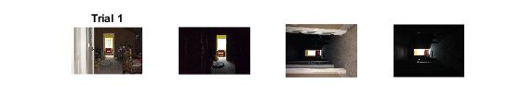
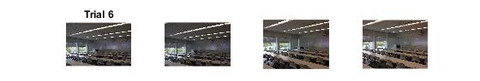
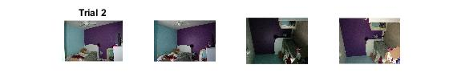
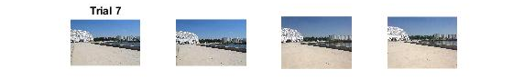
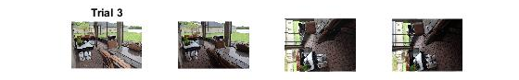
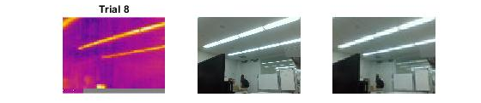
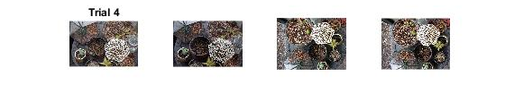
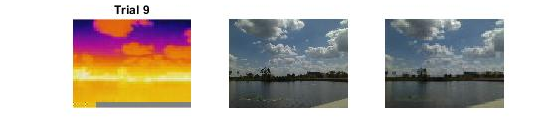
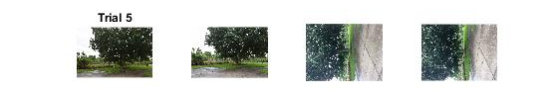

Slide 6
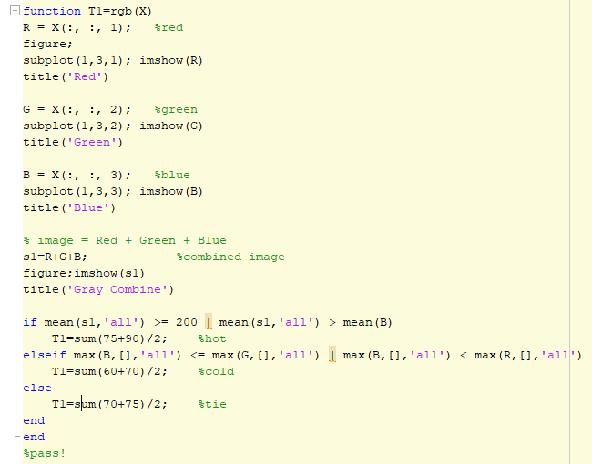
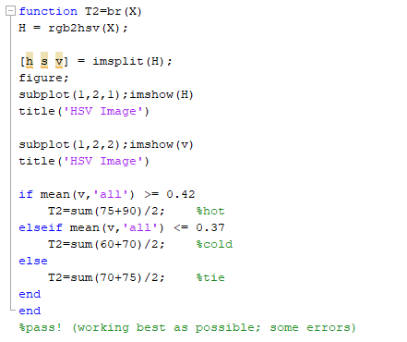
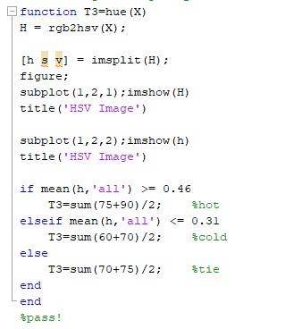
Feature extraction & classification

Slide 7
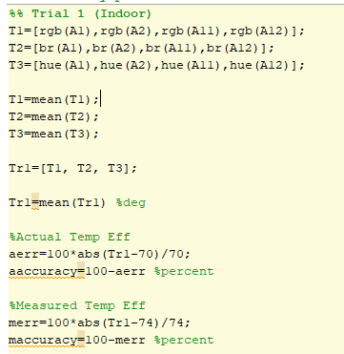
Test (80% Accuracy)
Trials | Temp | Actual Accuracy | Measured Accuracy | Outdoors
1 | 71.25 | 98.2143 | 96.2838 | no
2 | 78.3333 | 99.5726 | 91.2037 | no
3 | 76.875 | 71.875 | 79.8828 | yes
4 | 76.0417 | 83.0128 | 83.0128 | yes
5 | 73.125 | 78.125 | 87.5 | yes
6 | 72.0833 | 95.5314 | 99.8843 | no
7 | 79.1667 | 85.2657 | 93.018 | yes
8 | 80.2778 | 85.3175 | 90.0304 | no
9 | 81.3889 | 94.6382 | 83.0499 | yes
Avg Actual Accuracy: 87.9503%
Avg Measured Accuracy: 89.3184%

Slide 8
Issues
Thermal camera setup
More thermal images
Feature extraction & classification

Slide 9
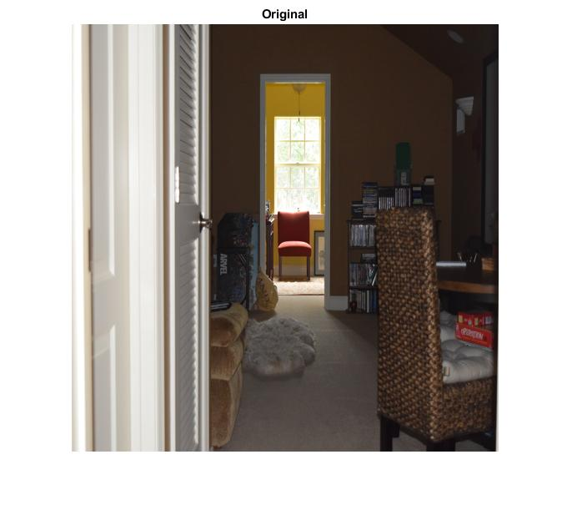
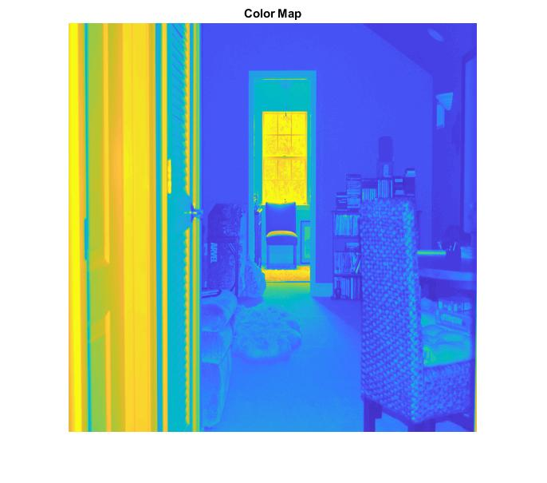
Future Work
Create color maps
Frequency filters
Assess trends of photos
Flash vs. no flash
Camera type
Webcam
Smartphone
Professional
Thermal (IR or RGB)
Indoors vs. outdoors

Slide 10

Acknowledgements
Jaimie Davis and Bryan Garcia
Expertise in thermal imaging connectivity
Dr. Ryan Integlia
Provision of two thermal cameras
Networking to colleagues in similar experiment
Vincent Jones
Prepping of professional camera

Slide 11
References
http://colorizer.org
https://www.mathworks.com
https://floridapolytechnic.instructure.com/courses/2993/files
https://classroom.udacity.com/nanodegrees/nd113/parts/3407b17c-2111-4484-bfb2-1725cf619a5c

